Slide 1



CAR SALES DASHBOARD
View in Power BI
Last data refresh:
3/18/2024 11:29:23 PM UTC
Downloaded at:
7/18/2024 1:24:41 AM UTC

Slide 2
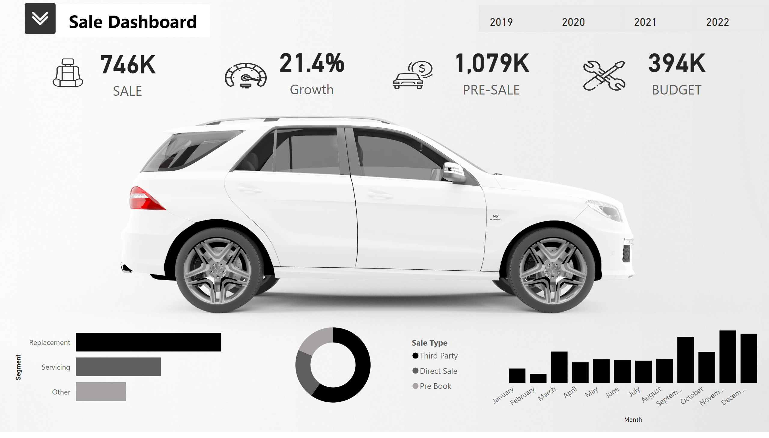
MY Dashboard
Notes:
image
No alt text provided
image
No alt text provided
image
No alt text provided
image
No alt text provided
SALE
No alt text provided
card
No alt text provided
card
No alt text provided
card
No alt text provided
clusteredBarChart
No alt text provided
donutChart
No alt text provided
clusteredColumnChart
No alt text provided
advancedSlicerVisual
No alt text provided
shape
No alt text provided
image
No alt text provided
image
No alt text provided
shape
No alt text provided
shape
No alt text provided
slicer
No alt text provided

Slide 3
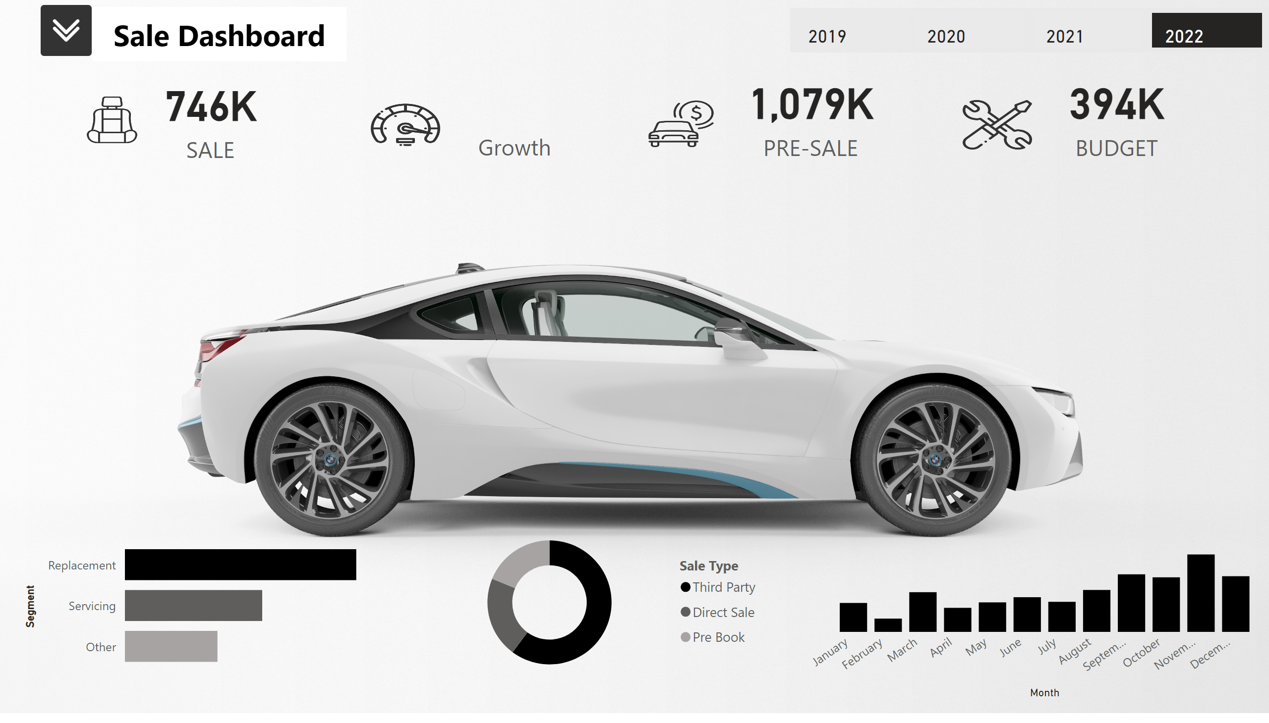
My DB 2021
Notes:
image
No alt text provided
image
No alt text provided
image
No alt text provided
image
No alt text provided
SALE
No alt text provided
card
No alt text provided
card
No alt text provided
card
No alt text provided
clusteredBarChart
No alt text provided
donutChart
No alt text provided
clusteredColumnChart
No alt text provided
advancedSlicerVisual
No alt text provided
shape
No alt text provided
image
No alt text provided
image
No alt text provided
shape
No alt text provided
shape
No alt text provided
slicer
No alt text provided

Slide 4
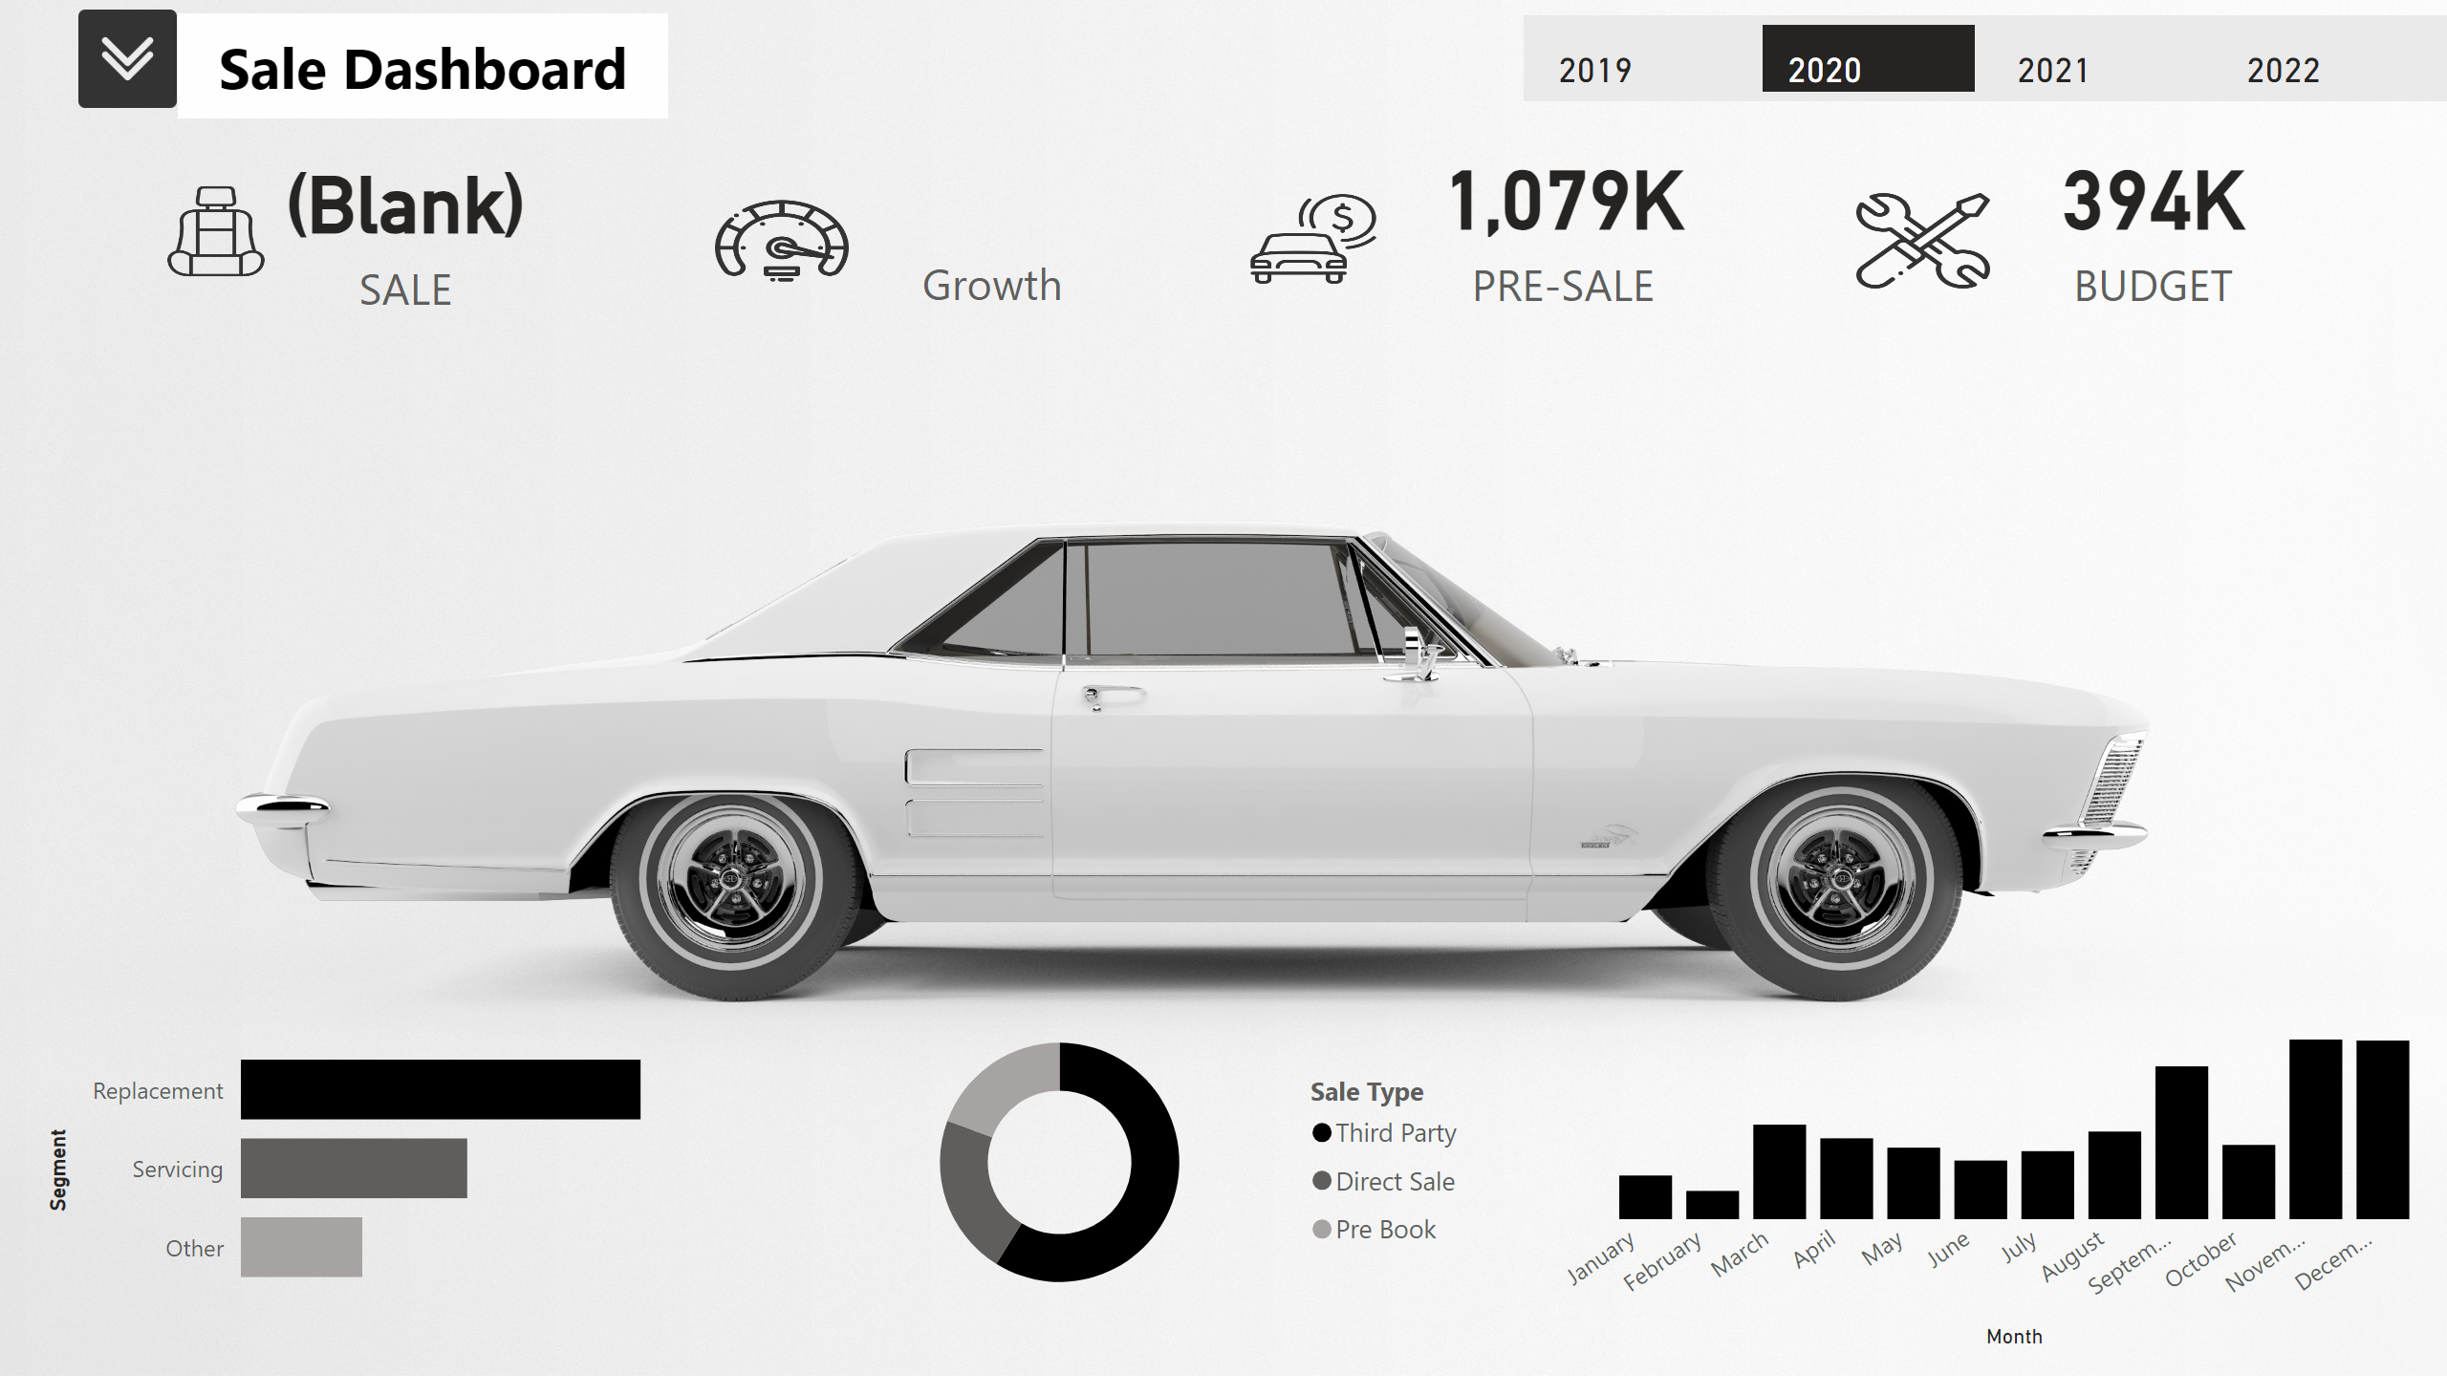
My DB 2020
Notes:
image
No alt text provided
image
No alt text provided
image
No alt text provided
image
No alt text provided
SALE
No alt text provided
card
No alt text provided
card
No alt text provided
card
No alt text provided
clusteredBarChart
No alt text provided
donutChart
No alt text provided
clusteredColumnChart
No alt text provided
advancedSlicerVisual
No alt text provided
shape
No alt text provided
image
No alt text provided
image
No alt text provided
shape
No alt text provided
shape
No alt text provided
slicer
No alt text provided

